Slide 1
Team B: EULA – NA East Karen Fine, Matt Marotto, Clifford Jones, Maria Carolina Bossert CARs to review: 173917114, 173917585, 173917263

Slide 2
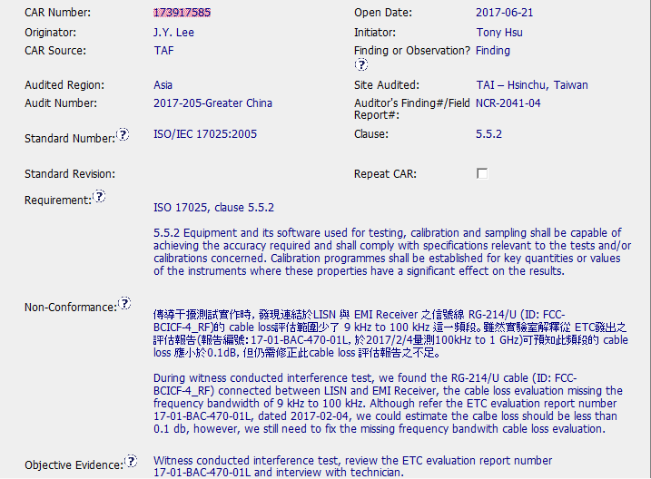

Slide 3
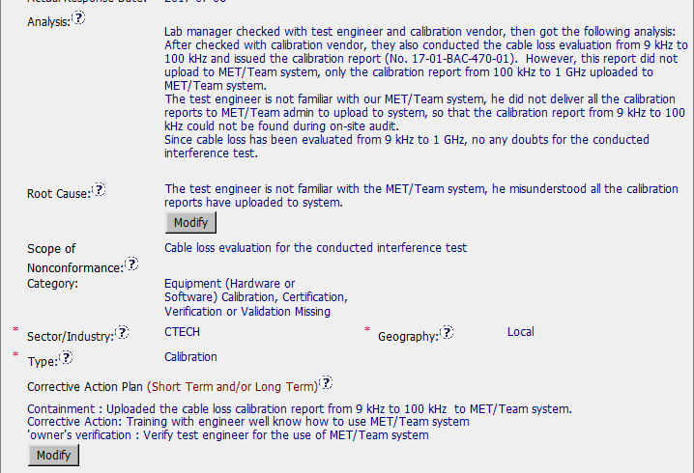

Slide 4
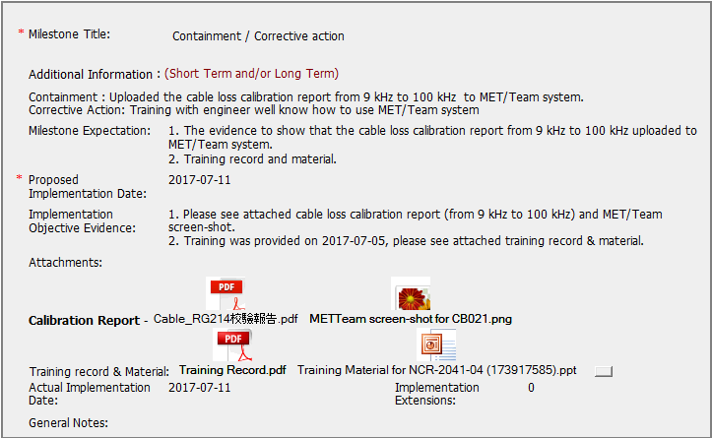

Slide 5
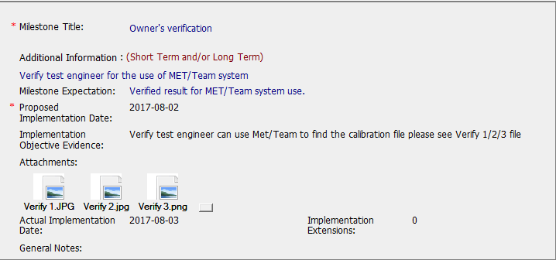

Slide 6
CAR Review - 173917585
Is the nonconformity is fully addressed in the analysis?
The nonconformity is not fully addressed in the analysis.
The analysis is not detailed enough to discover the real root cause. At least, one more question is needed: “why is the test engineer is not familiar with the MetTeam system?
The analysis does not mention what process is involved and why was the nonconformance not detected.
The analysis suggest that the staff member upload one frequency range of the impedance measurements to MetTeam but did not upload the lower frequencies. So, there is objective evidence that the staff member knew how to update MetTeam.
Does the analysis supports the root cause statement?
The analysis does not support the root cause statement.
The root cause indicates that the staff member misunderstood the MetTeam system, yet was able to upload one set of measurements at the higher frequency but did not know that all measurements needed to upload. This is not a MetTeam issue but a training issue.
Does the analysis support the Scope of Nonconformance statement?
No, the analysis does not support the scope of Nonconformance.
Scope of nonconformance does not describe how widespread the problem is. The scope indicates that the defect is limited to only a single cable. However, EMC lab’s have multiple cables. No analysis was performed to determine the scope of the non-conformance.
Will the Corrective Action Plan will prevent the recurrence of the nonconformity?
No, the Corrective Action Plan will not prevent a reoccurrence as the analysis which lead to the Root Cause was not robust. The test engineer does not understand the criteria for storing the characterization measurements. This is not a tool problem but appears to is a competency issue.

Slide 7
CAR Review - 173917585
Did the containment milestone “stopped the bleeding”?
Containment action stopped the bleeding since actions were taken to fix the problem found in the objective evidence, while awaiting for the long term actions.
The Containment/corrective action was to upload the missing characterization file to MetTeam.
Did all corrective action milestones are aligned to each item of the corrective action plan?
Milestones are aligned with the corrective action plan proposed, but corrective action plan is not enough to cover the scope and prevent future reoccurrences.
Did the verification milestone confirmed the effective implementation of the corrective action plan?
Verification milestone is ok, since it includes examples of the. effective implementation of the corrective action proposed

Slide 8
Finding CAR
Car 173917585 Explain how/If the analysis supports the Scope of Nonconformance statement - JIM
It does not. There was no investigation of how widespread the issue was. The scope of nonconformance only states “Cable loss evaluation for the conducted interference test”.
The analysis did not support the scope.

Slide 9
CAR 173917585 Explain how/If the containment milestone “stopped the bleeding” - JIM
The containment action is training, which is also the corrective action for this CAR. The CAR was opened on June 21, and the containment milestone was completed July 11, with training completed July 5.
The Containment milestone appeared to ‘stop the bleeding’ and in a timely manner

Slide 10
CAR 173917585 Confirm that/If all corrective action milestones are aligned to each item of the corrective action plan - JIM
Correction Action Plan has three items: containment, corrective action, and owner’s verification.
There are two milestones: combined containment/corrective action and owner’s verification.
The milestones align to each item in the corrective action plan.

Slide 11
CAR 173917585 Explain how/If the verification milestone confirmed the effective implementation of the corrective action plan - Chris
The verification milestone fully addresses the effective implementation of the corrective action by evaluating the knowledge of the staff member.

